Slide 1
Ways of Working
Purpose of the Legal Assistance Sector Trauma-Informed Community of Practice (CoP) The CoP aims to foster collaboration, share best practices and provide sector-wide resources in trauma-informed legal assistance. The CoP has been established as a safe and connected group that is innovative and driven by the legal assistance sector workforce to support trauma-informed practices in legal assistance. We want a system that recognises adverse experiences, responds in ways that minimise re-traumatisation and provides compassionate legal assistance.
We are trauma-informed, rights-based and strengths-based | We are committed to a trusting, emotionally, psychologically and culturally safe environment We will not share names, confidential or personal details outside the CoP We will respectfully listen and respond to emotionally challenging situations We are all responsible for shaping the culture of the CoP to be strengths-based
We provide a safe space to discuss the impact of trauma on clients and on the well-being of the legal assistance sector workforce | This is a collaborative learning space and not intended to be a personal therapeutic space We acknowledge the emotional impact of our work and we are committed to understanding what we can do to support self-care
We have a commitment to addressing power imbalances | We recognise the impact of power differentials between clients, staff employed in lived experience positions and other disadvantaged groups We value and promote unique perspectives and the diversity of experience with CoP members We are committed to elevating the voices of people with a lived experience of trauma into designing and delivering the legal assistance sector services
We are committed to confidentiality | We will share the information received, but will NOT reveal the identity of the person or who said it or their organisation

Slide 2
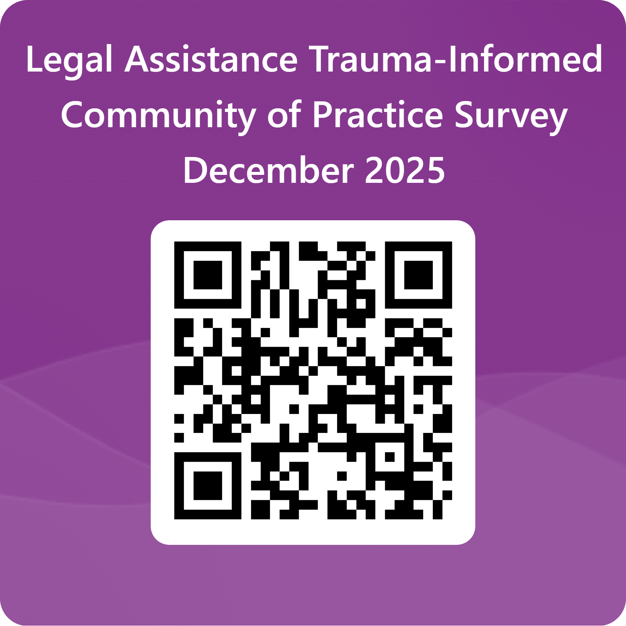
Survey Link
Community of Practice Survey December 2025

Slide 3

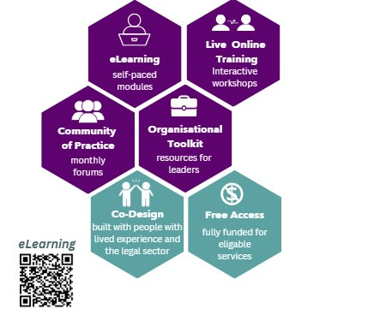
further Learning
Self-Paced eLearning
Live Online Training
Trauma-Informed Organisational Toolkit
Co-Design in the National Legal Assistance Sector
Contact

